Slide 1

JAYOTI VIDYAPEETH WOMEN’S UNIVERSITY A Survey paper for Face Recognition Technologies
Presented By:- JV’n Urvashi & JV’n Aprajita
JV-d/17/1333 & JV-i/17/1645 DET CSE Faculty Of Engineering And Technology

Slide 2
Contents
INTRODUCTION
FACE RECOGNITION ALGORITHMS
DISCUSSION AND REMARKS
CONCLUSION

Slide 3
INTRODUCTION
Face recognition is an important part of the capability of human perception system and is a routine task for humans , while building a similar computational model of face recognition. The computational model not only contribute to theoretical insights but also to many practical applications like automated crowd surveillance, access control, design of human computer interface (HCI), content based image database management, criminal identification and so on. The earliest work on face recognition can be traced back at least to the 1950s in psychology
and to the 1960s in the engineering literature
Some of the earliest studies include work on facial expression emotions by Darwin
But research on automatic machine recognition of faces started in the 1970s and after the seminal work of Kanade
In 1995, a review paper
gave a thorough survey of face recognition technology at that time
At that time, video-based face recognition was still in a nascent stage. During the past decades, face recognition has received increased attention and has advanced technically.
Recently, significant research efforts have been focused on video-based face modeling/tracking, recognition and system integration.

Slide 4
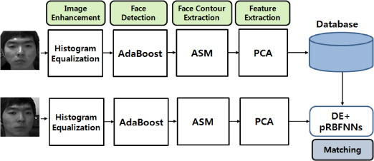
FACE RECOGNITION ALGORITHMS
face recognition algorithm is built to identify various facial features by extracting identifying landmarks known as features on a person’s face. The algorithm detects and analyzes features based on their position relative to other features. Examples include the size, shape and placement of the nose, jaw and cheekbones. A sophisticated facial recognition algorithm can be used to identify an individual utilizing thousands of features on their face and then comparing those features against a database of photographs.
Face recognition algorithms can protect privacy and secure data.
there are two primary approaches to facial recognition algorithms. The first is geometric. Geometric face recognition algorithms endeavor to identify distinguishTing features. The second is known as a photometric approach.

Slide 5
LITERATURE SURVEY
Face recognition has been an active research area over last 40 years. The face recognition research has several disciplines such as image processing, machine learning approach, pattern recognition, computer vision, and neural networks. Classification is the main problem. In the process of face recognition it includes, to train the face images from the known individuals and then to classify the newly coming test images into one of the classes. The problem of face recognition is easily solved by Humans where limited memory can be the main problem. The problems or limitations for a machine learning face recognition system are: 1. Facial expression change 2. Illumination variation 3. Ageing 4. Pose change 5. Scaling factor (i.e. size of the image) 6. Frontal vs. profile 7. Presence and absence of spectacles, beard, mustache etc. 8. Occlusion due to scarf, mask or obstacles in front. In automatic face recognition system the main complicated task is that it involves detection of faces from a cluttered background, facial feature extraction, and face recognition. A complete face recognition system has to solve all sub-problems, where each one is a separate research problem. Image template based and geometry feature-based are the two classes of face recognition system algorithms. In template based method it (Robert J. 1981 ) compute the correlation between a face image and one or more model of face image templates to estimate the face image identity from the database. Brunelli and Poggio (R. Brunelli, 1993) suggest the optimal strategy for face recognition system which is holistic and corresponds to template matching. The statistical tools such as Support Vector machines (SVM) (E. Osuna, 1997), (Vladimir N, 1995) Independent component Analysis, Principal Component Analysis (PCA) (L. Sirovich, 1987), (Matthew Turk, 1991), Linear Discriminant Analysis (LDA) (Peter N.Belhumeur et.al, 1997), kernel methods (Bernhard Scholkopf et.al, 1998 ), (M. H. Yang, 2002), and neural networks (A. Jonathan, 1995), (Steve Lawrence, 1998), (T. Poggio, 1994) used to construct a suitable database of face image templates.

Slide 6
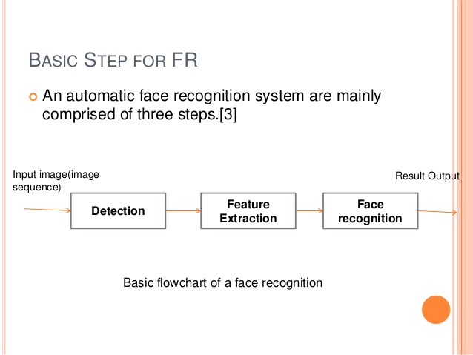
DISCUSSION AND REMARKS
In this paper, we presented some major issues on face recognition. These are as follows:
Face detection: For the constrained conditions, many face detection methods for static image are not directly suitable to the task in video. We classified current approaches into groups, and summarized their pros and cons
Face tracking: In face tracking head rotation and pose variations are measure issues. Face tracking is a significant procedure in face recognition. It usually exploits statistical model, example-based model, and skin color information to accomplish the tracking task. In addition, for these methods it also exploits CAMSHIFT, condensation, adaptive Kalman filter algorithms.
Face recognition: Since the spatio-temporal information plays a significant role in face recognition, how to fully exploit redundancy information in the video sequence is a key issue for video based recognition. One of the chief advantages of video over still frames is that fact accumulation over multiple frames can provide better face recognition performance.

Slide 7
CONCLUSION
This paper has attempted to review a significant number of papers to cover the recent development in the field of face recognition. Face recognition is a both exciting and important recognition technique. Among all the biometric techniques, face recognition approach holds one great advantage, which is its userfriendliness. In this paper, we have given an introductory survey for the face recognition technology. This paper can provide the readers a better understanding about various face recognition systems, and we encourage the readers who are fascinated in this topic go to the references for more complete study.
Consequently, face recognition in video possesses more challenges to the current face recognition systems. Use of three dimensional face image models has been suggested as a way to compensate for low resolution, low dimension, poor contrast and non-frontal pose.

Slide 8
THANK YOU

